Slide 1

PrintEase: Adaptive Priority Scheduling for Efficient Academic Printing
Design and Analysis of Algorithm
Subject code : CSA0612
Presented BY:
Manoj M(192511060)
Theshon Mishmaan M(192572106)
Yokesh (192424174)
Jaya Krishna (192421259)
Dinesh (192424016)
Guided BY:
Dr. Poongavanam N

Slide 2


Introduction
PrintEase is an academic printing management system for campus environments.
Enables digital submission and management of print requests.
Uses Adaptive Priority Scheduling to dynamically prioritize print jobs.
Applies aging to increase the priority of waiting jobs.
Uses a Binary Max-Heap for efficient job selection.
Helps reduce waiting time and prevent starvation.
Improves the overall efficiency of print-job scheduling.

Slide 3
Problem Statement
Manual print-job management leads to delays and inefficient processing.
FCFS scheduling may cause urgent print requests to wait unnecessarily.
Fixed priority scheduling can cause starvation for low-priority jobs.
Waiting print jobs do not receive dynamic priority adjustments.
During peak hours, increasing print requests can result in long waiting times.
A scheduling system is needed to dynamically prioritize jobs and improve printing efficiency.

Slide 4
Objectives
To develop an efficient academic print-job scheduling system.
To implement Adaptive Priority Scheduling for dynamic job prioritization.
To use a Binary Max-Heap for efficient selection of print jobs.
To reduce average waiting and turnaround time.
To prevent starvation by applying an aging mechanism.
To improve the overall efficiency and responsiveness of the printing process.

Slide 5
Literature Survey
S.No | Authors & Year | Journal / Conference | Technique / Contribution | Limitations
1 | Mustafa et al. (2025) | International Journal of Computer Applications | Cloud-based automated print queue management | LIFO is not suitable for priority/urgent jobs.
2 | Dhabliya et al. (2025) | ShodhKosh Journal | Cloud-based print management with secure printing | Depends on network and has security challenges.
3 | Li et al. (2024) | IEEE Access | Print-job sequence optimization and scheduling | Mainly designed for industrial printing systems.

Slide 6
Existing System Flow
Print requests are often managed through manual or FCFS-based scheduling.
Jobs are processed mainly according to their arrival order.
Urgent print requests may experience unnecessary delays.
Fixed-priority methods can lead to starvation of low-priority jobs.
Priority of waiting jobs is not dynamically updated.
High request volumes can result in long waiting and turnaround times.
Limited scheduling optimization leads to inefficient printer utilization.

Slide 7

Proposed System Flow
Provides a digital platform for submitting and managing print requests.
Uses Adaptive Priority Scheduling to dynamically prioritize print jobs.
Applies an aging mechanism to increase the priority of waiting jobs.
Uses a Binary Max-Heap for efficient highest-priority job selection.
Processes urgent and normal print requests based on their dynamic priority.
Reduces waiting time and starvation during peak workloads.
Improves overall printer utilization and scheduling efficiency.

Slide 8
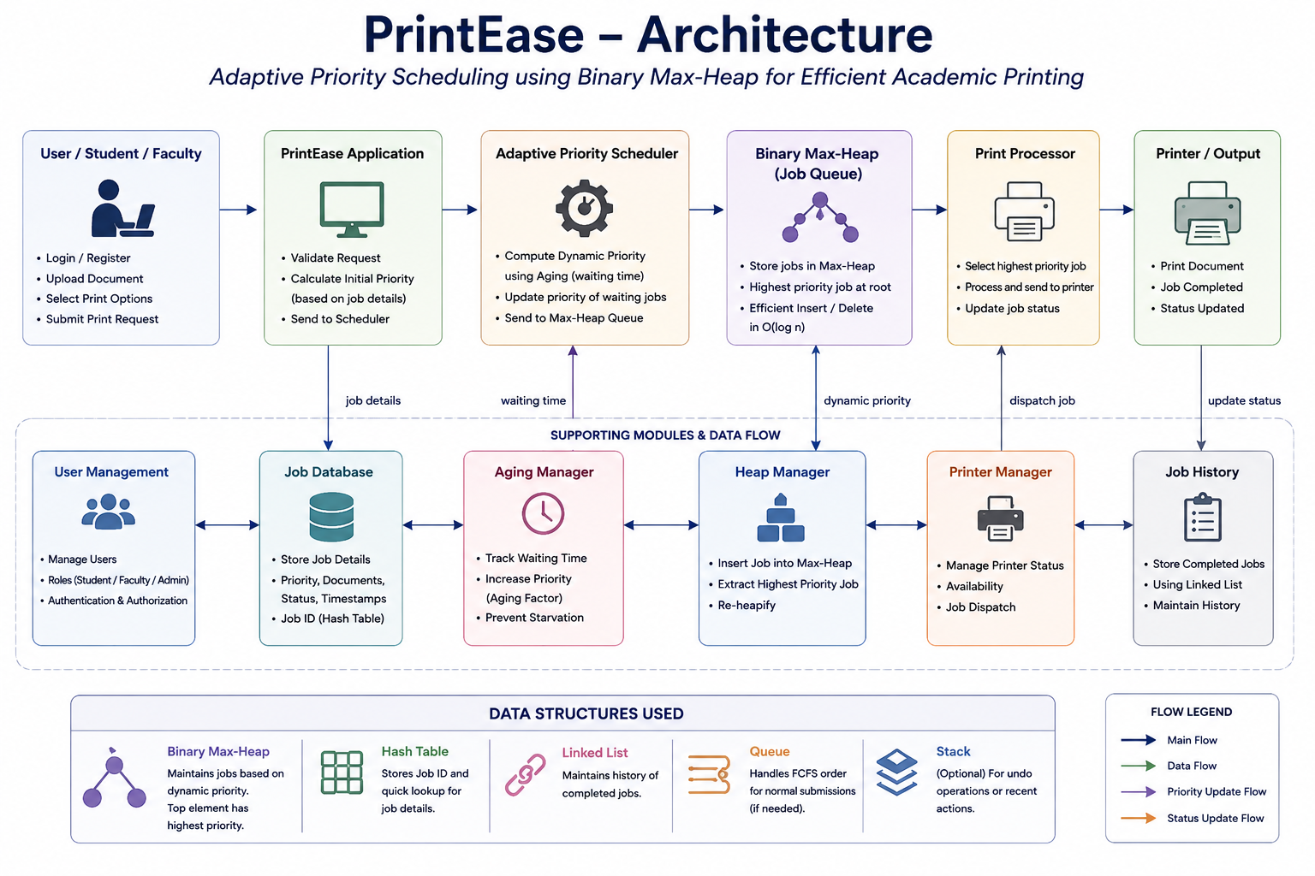
PrintEase System Architecture

Slide 9
Algorithm Used
Adaptive Priority Scheduling
Assigns an initial priority to each print request.
Calculates a dynamic priority based on job urgency and waiting time.
Applies aging to increase the priority of waiting jobs.
Stores print jobs in a Binary Max-Heap.
The job with the highest dynamic priority is selected first.
After processing a job, the queue is updated and re-heapified.
Helps reduce starvation and waiting time.

Slide 10
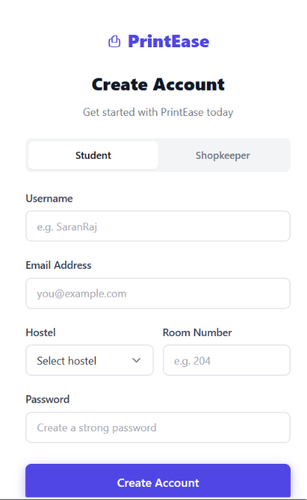
Module 1 -User & Print Requirement Management
User Registration & Login
Manage student, faculty, and admin users.
Submit new print requests.
Enter document details such as pages, copies, color, and print type.
Assign a unique Order ID to each print request.
Forward the request to the Priority Calculation Module for scheduling.

Slide 11
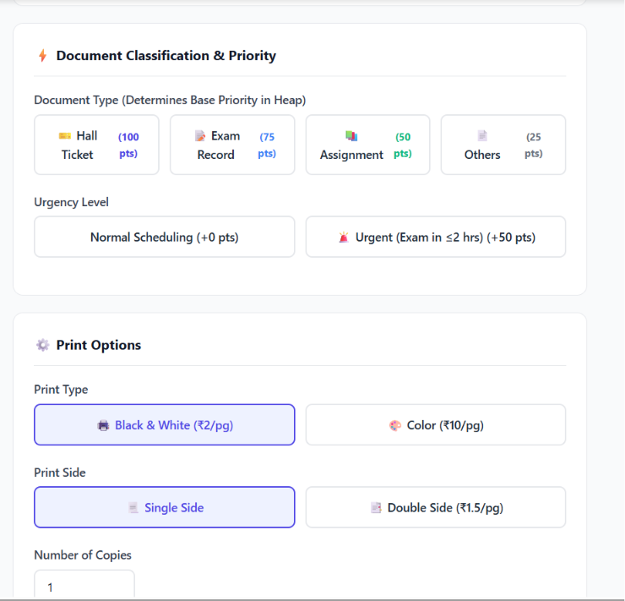
Module 2: Priority Calculation Module
Receives the print request from Module 1.
Assigns an initial priority to each print job.
Considers factors such as urgency, user type, and print requirements.
Calculates the priority score for each job.
Passes the calculated priority to the Adaptive Priority Scheduling Module.
Provides the initial value used for dynamic priority updates.

Slide 12
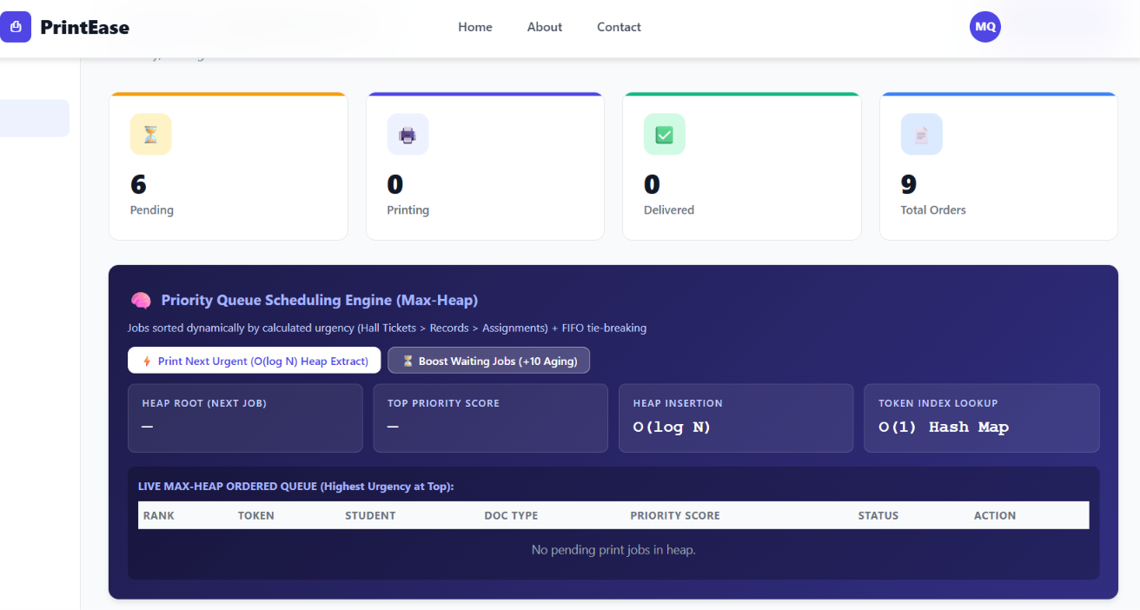
Module 3: Adaptive Priority Scheduling
Receives print jobs along with their initial priority scores.
Calculates priority dynamically based on waiting time.
Applies aging to increase the priority of waiting jobs.
Continuously updates the priority of pending print requests.
Prevents starvation of low-priority print jobs.
Determines the next job to be processed based on the updated priority.
Sends the dynamically prioritized jobs to the Binary Max-Heap for efficient scheduling.

Slide 13
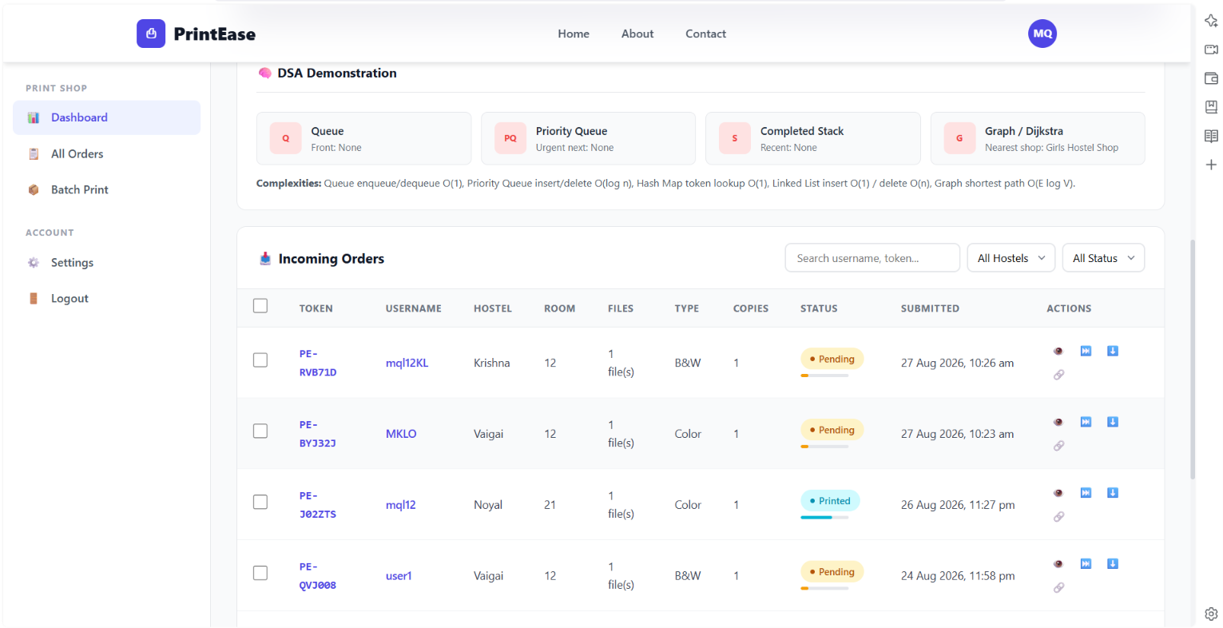
Module 4: Print Processing & Status Management
Processes print jobs selected by the Adaptive Priority Scheduler.
Updates the status of each print request.
Tracks Pending, Processing, and Completed jobs.
Calculates print completion details.
Records the processing time of each job.
Sends completed jobs to the Order History Module.

Slide 14
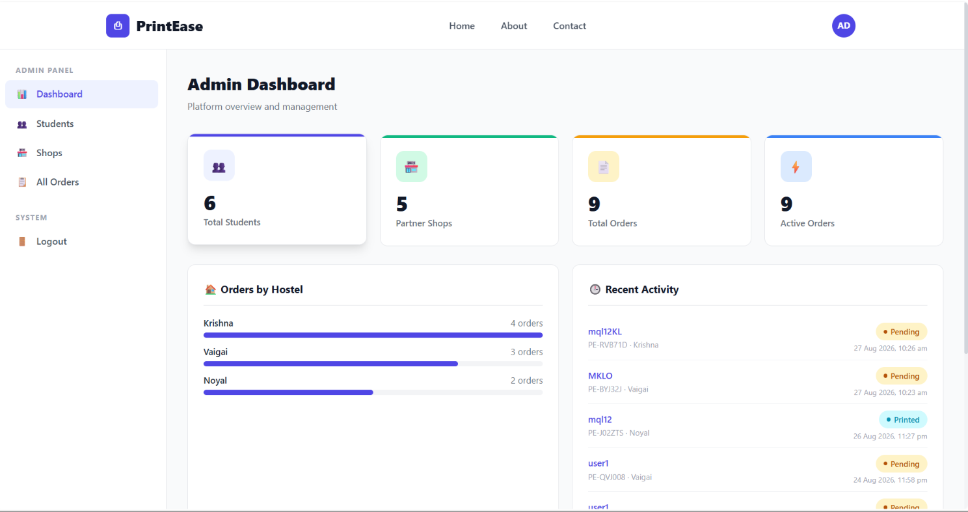
Module 5: Order History & Admin Monitoring
Maintains the history of completed print requests.
Tracks orders using a unique Order ID.
Allows admin to monitor pending and completed jobs.
Displays scheduling information such as priority and waiting time.
Provides basic print activity reports.
Helps admin monitor overall system performance.

Slide 15
DAA Algorithm Flow
Step 1: User submits a print request ↓ Step 2: Calculate initial priority ↓ Step 3: Calculate waiting time ↓ Step 4: Apply aging and update priority ↓ Step 5: Select the highest-priority job ↓ Step 6: Process the print job ↓ Step 7: Update remaining jobs ↓ Step 8: Repeat until all print jobs are completed

Slide 16
Future Scope
Multi-Printer Support — Automatic printer selection and workload balancing.
Real-Time Notifications — Instant updates for print-job status.
Advanced Scheduling — Dynamic priority based on waiting time, urgency and resources.

Slide 17
Conclusion
PrintEase provides a digital and organized solution for managing academic print requests.
FCFS and Priority Scheduling improve the ordering and handling of normal and urgent print jobs.
Pipelining improves print-processing throughput by dividing the process into sequential stages.
I/O Organization enables communication between the system and printer while monitoring print status.
The system reduces dependency on manual print-center operations and provides a more efficient printing workflow.
Future integration of database, cloud services, multiple printers, notifications, and advanced scheduling can make PrintEase more scalable and production-ready.

Slide 18
References
Antonio, C. C. (2020). High Performance Computing for Big Data in Distributed Systems. Distributed Processing Systems, 1(2), 10–17. https://doi.org/10.38007/DPS.2020.010202
Burova, E., Grishunin, S., Suloeva, S., and Stepanchuk, A. (2021). The Cost Management of Innovative Products in an Industrial Enterprise Given the Risks in the Digital economy. International Journal of Technology, 12(7), 1339–1348. https://doi.org/10.14716/ijtech.v12i7.5333
Dan, H. (2023). Exploring the Innovative Path of Human Resources Management of Construction Enterprises in the Internet Plus Era. Modern Economics and Management, 4(1), 63–65.
Eshov, M. A. N. S. U. R. (2020). Influence Assessment of Enterprise Management Value Based on Coefficients Methods Under the Risk Conditions. Advances in Mathematics: Scientific Journal, 9(9), 7573–7598. https://doi.org/10.37418/amsj.9.9.104
Ferreira, J. J., Lopes, J. M., Gomes, S., and Rammal, H. G. (2023). Industry 4.0 Implementation: Environmental and Social Sustainability in Manufacturing Multinational enterprises. Journal of Cleaner Production, 404, 136841. https://doi.org/10.1016/j.jclepro.2023.136841

Slide 19
Thank you

